Slide 1
SQL Server R Services ABQSQL, January 22, 2016

Slide 2
About Me
Chris Hyde
Owner and Principal Consultant for Hydrate Consulting
MCSA – SQL Server 2008, MCITP
15+ Years experience with SQL Server
Contact Me:
Email: chris@hydrate.consulting, chrishyde325@gmail.com
Twitter: @ChrisHyde325

Slide 3

Before we begin…

Slide 4
What is this R you speak of?
“R is a language and environment for statistical computing and graphics.”
“R provides a wide variety of statistical and graphical techniques, and is highly extensible.”
“Many users think of R as a statistics system. We prefer to think of it of an environment within which statistical techniques are implemented.”
https://www.r-project.org/about.html

Slide 5
You got R in my SQL! No, you got SQL in my R!
Microsoft purchased Revolution Analytics in April 2016.
Revolution’s distribution of R will be integrated in SQL Server 2016 under the name of SQL Server R Services.
First available in CTP 3.0.

Slide 6
But what can I do with R anyway?
Demo #1: Predicting free disk space

Slide 7
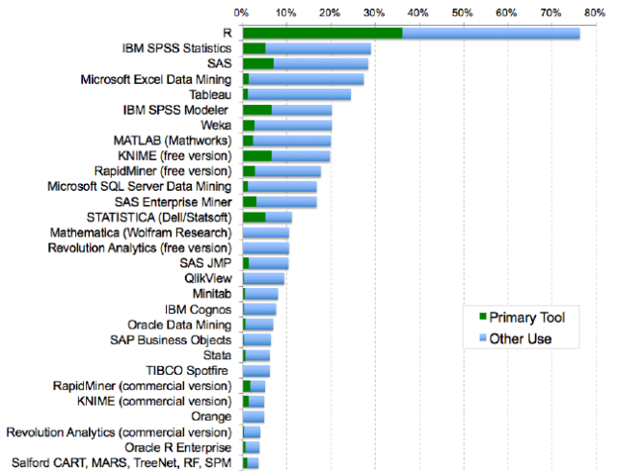
R
Source: TBD

Slide 8
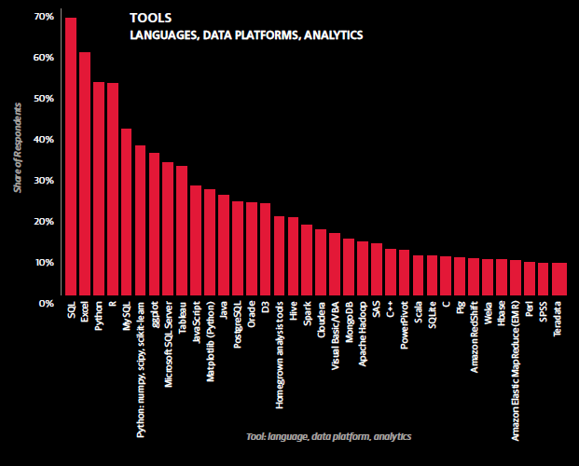
R
Source: TBD

Slide 9
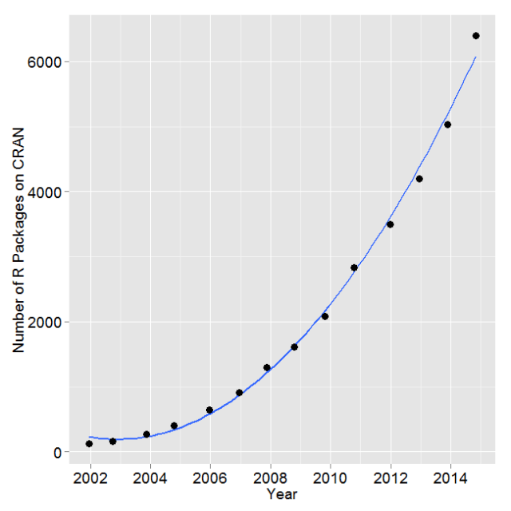
Exponential Growth of R Packages
Source: TBD

Slide 10
Installing SQL Server R Services, part 1
1. Install Advanced Analytics Extensions
https://msdn.microsoft.com/en-US/library/mt590808.aspx

Slide 11
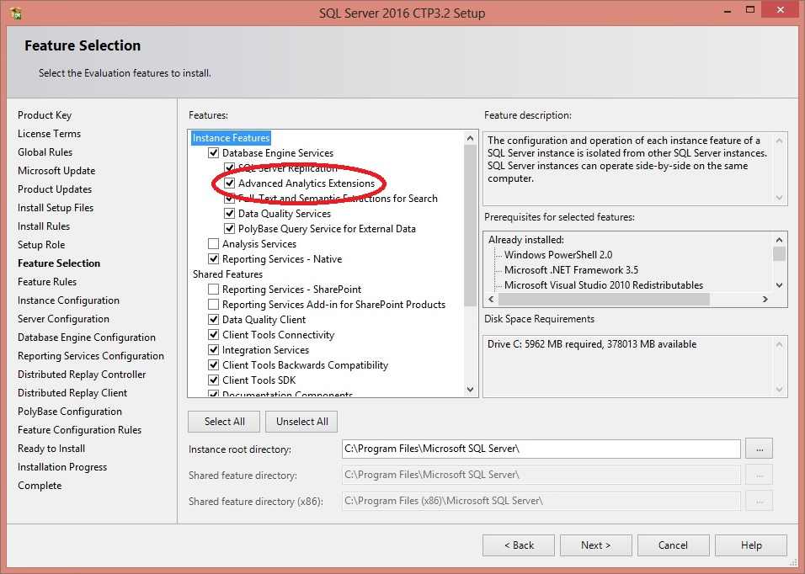
Installing SQL Server R Services, part 2

Slide 12
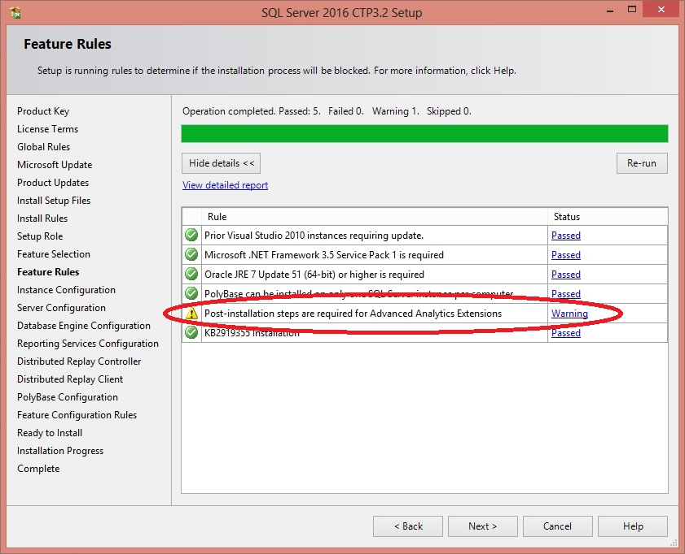
Installing SQL Server R Services, part 3

Slide 13
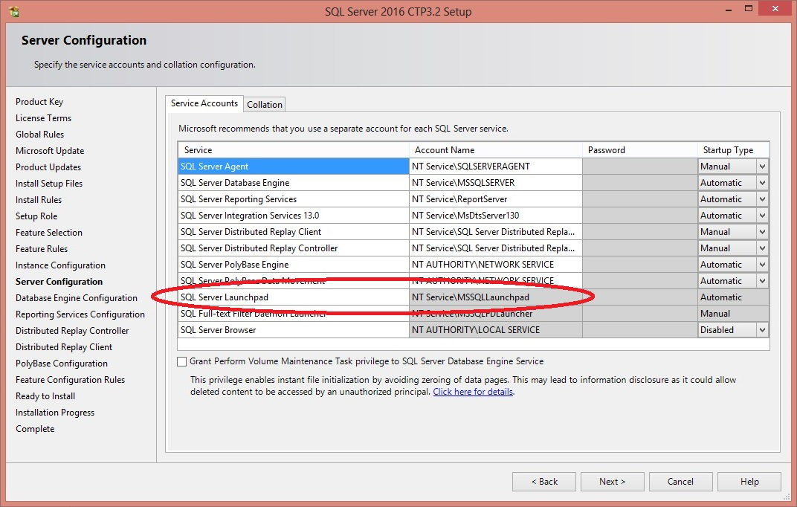
Installing SQL Server R Services, part 4

Slide 14
Installing SQL Server R Services, part 5
2. Install Revolution R Open 3.2.2 on database server
(R runtime engine)
3. Install Revolution R Enterprise 7.5 on database server
(R platform)
https://msdn.microsoft.com/en-US/library/mt590809.aspx

Slide 15
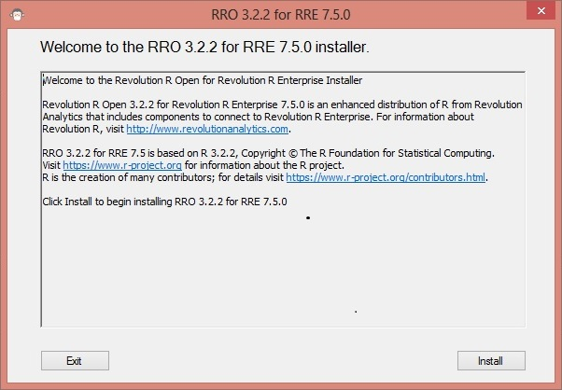
Installing SQL Server R Services, part 6

Slide 16
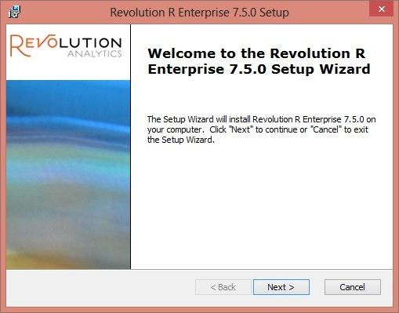
Installing SQL Server R Services, part 7

Slide 17
Installing SQL Server R Services, part 8
Post-installation scripts and configuration
1. Enable external scripts
EXEC sp_configure 'external scripts enabled', 1;
RECONFIGURE;
2. Configure memory appropriately
3. Post-installation command script
https://msdn.microsoft.com/en-US/library/mt590536.aspx

Slide 18
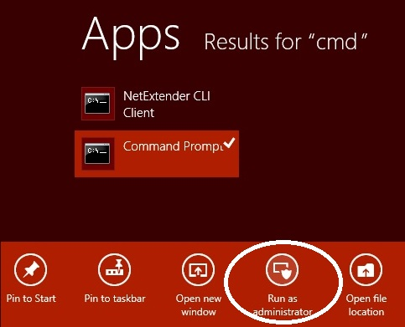
Installing SQL Server R Services, part 9

Slide 19
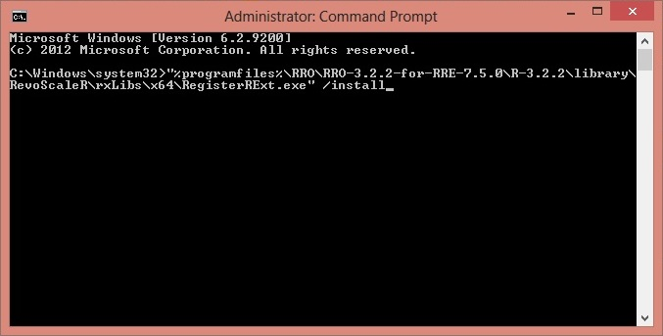
Installing SQL Server R Services, part 10

Slide 20
Getting Data Into and Out Of R
DEMO

Slide 21
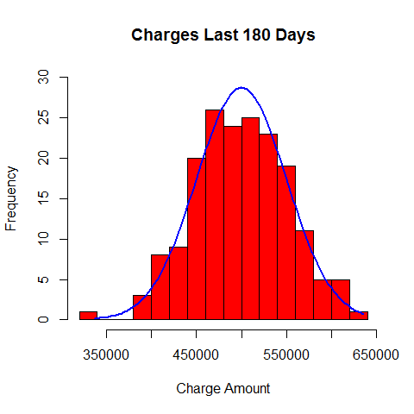
Distribution of Charges

Slide 22
Distribution of Charges
DEMO

Slide 23
Overbooking
DEMO

